Slide 1
Configuring Raspberry Pi
Steps prior to using the server code

Slide 2
Newest version of OS
We will be using the latest version of the RASPBIAN JESSIE (link)
Full version, NOT the LITE version
Other OS work great, but this is what the rest of tutorials assume, so minor adjustments will need to be made if picking a different distro of Linux
RaspberryPi.org has best documentation for this https://www.raspberrypi.org/documentation/installation/installing-images/

Slide 3
Getting to the command line
Once you load your new OS to your Pi you will need to set it up with a monitor
NOTE: If you know a way without a monitor LET ME KNOW!
We need to get to the GUI interface and change the Raspberry Pi Configuration to boot up to the command line logged in.

Slide 4
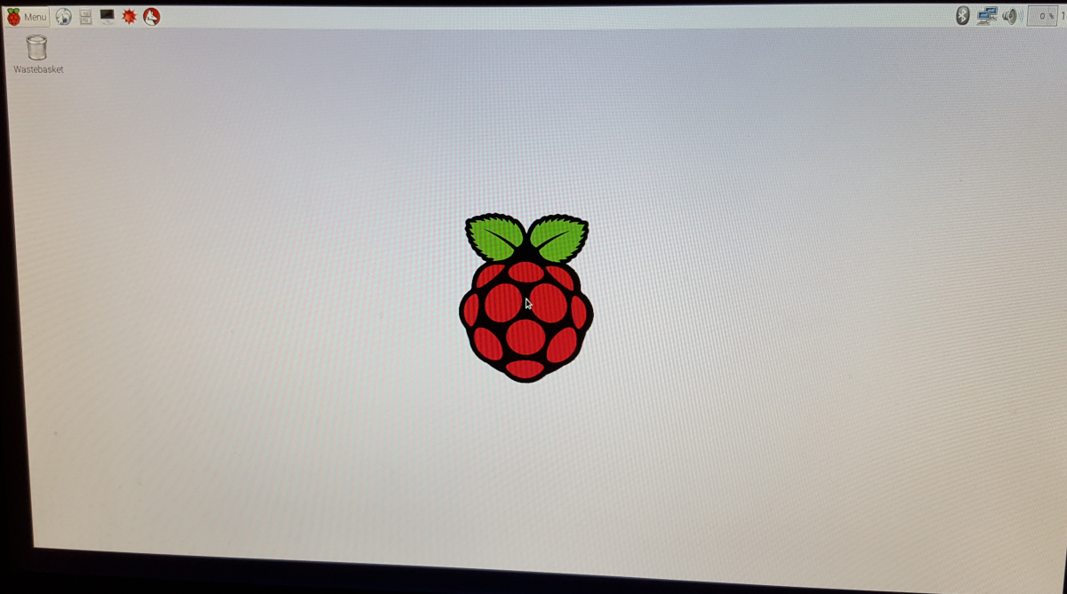
This is the Desktop view

Slide 5
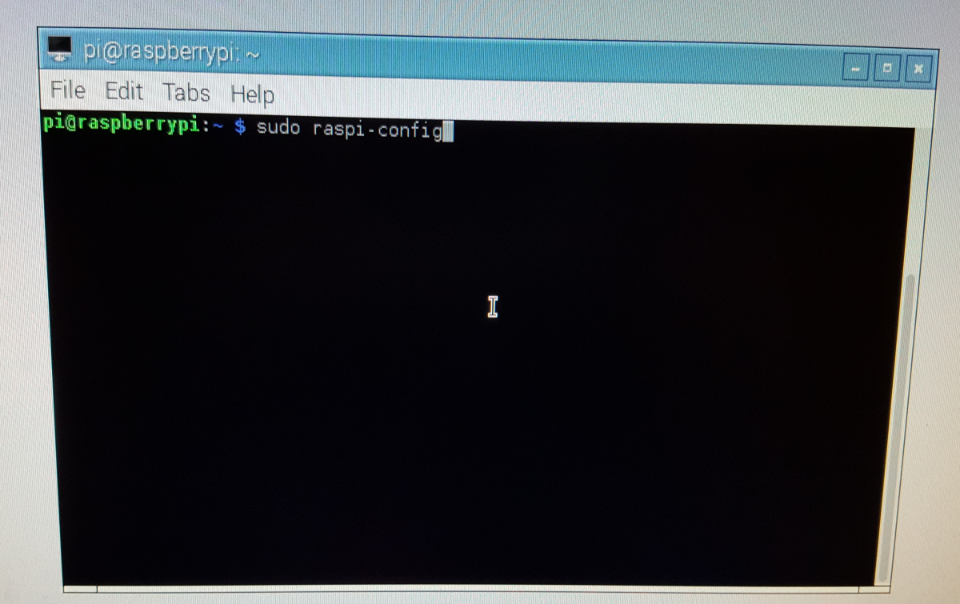
Either find the “Terminal” or type “Ctrl+Alt+T” to open it
Type “sudo raspi-config” and hit Enter

Slide 6
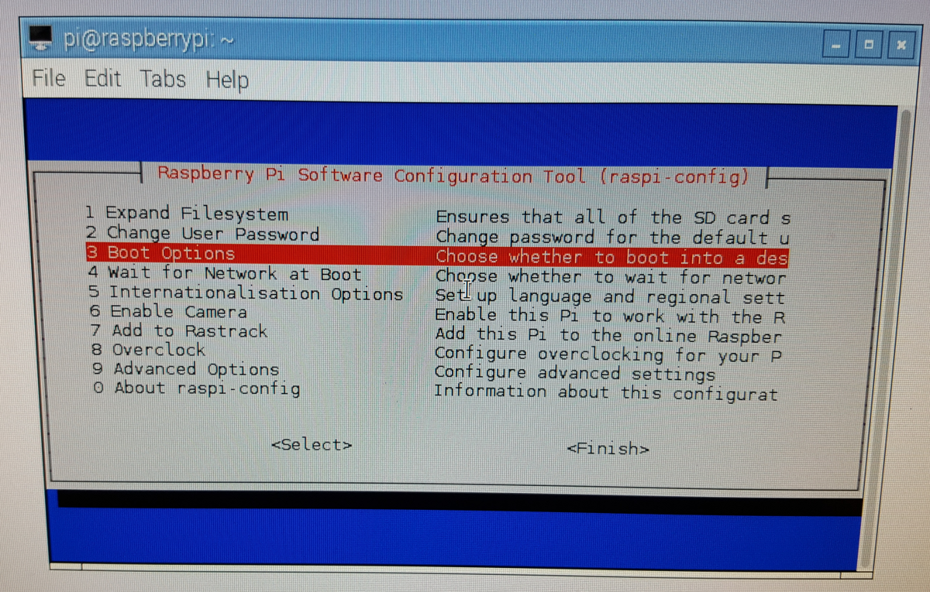
This will bring up the Pi’s configuration menu
Use arrow keys to select option 3 (“Boot Options”)

Slide 7
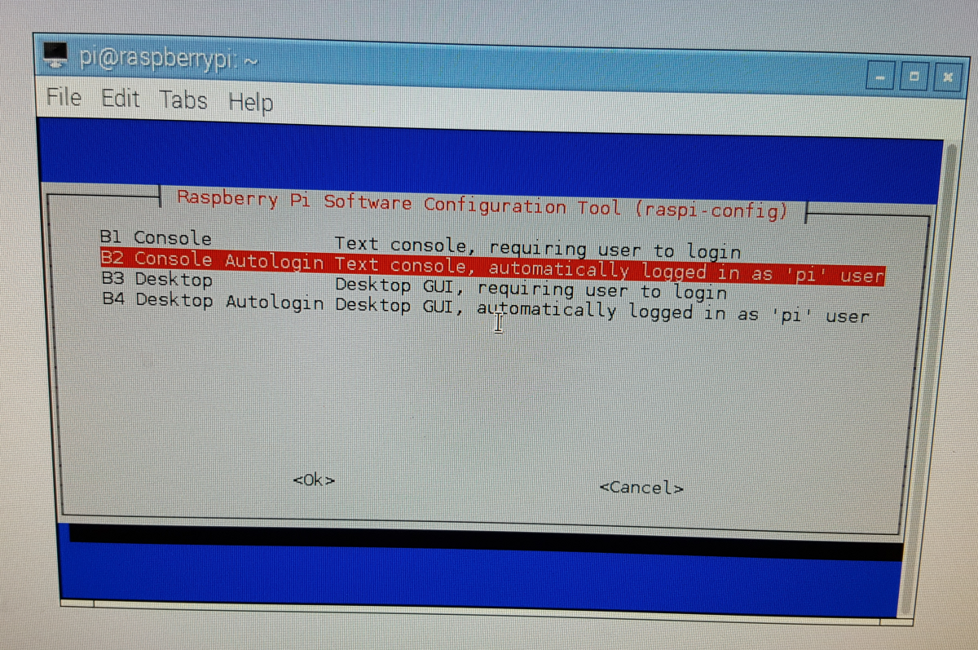
Select “Console AutoLogin” to have the Pi boot up to the console with logged in.
You can now exit the configuration menu

Slide 8
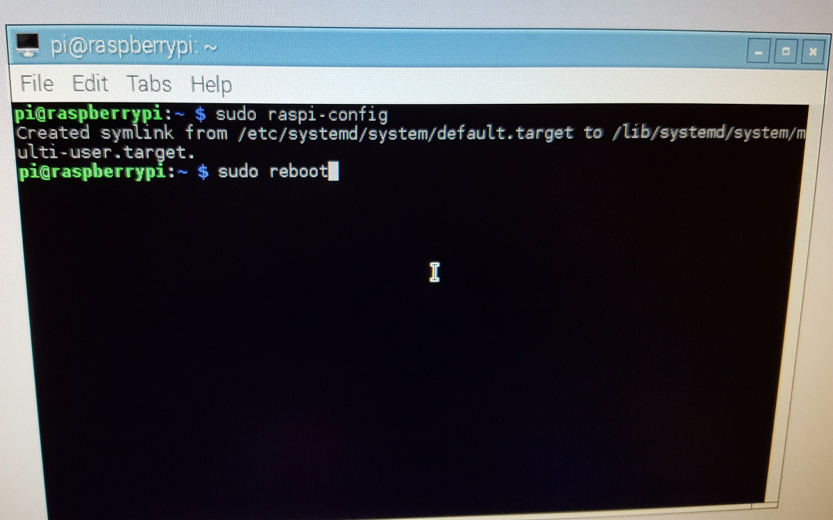
Either power off your Raspberry Pi or type “sudo reboot” to restart the Pi

Slide 9
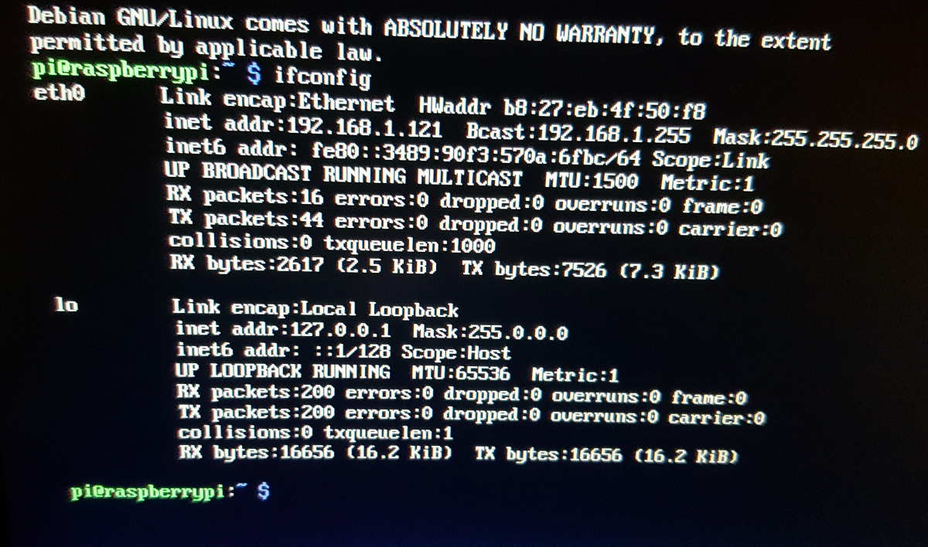
To SSH into the Pi we need it’s IP Address, here are 3 options
Type “ifconfig” and find it
Log into your router and see where it is connected to
Set the /etc/network/interfaces config file to have a static IP

Slide 10
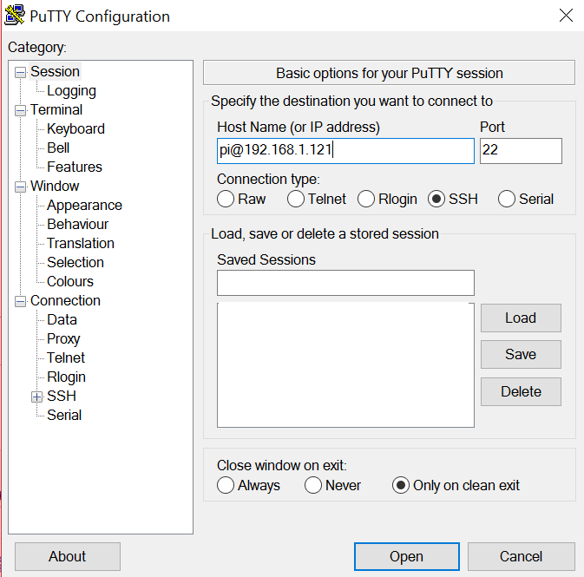
SSH into your Pi Password: raspberry
My recommendation is to download Putty if you are using Windows
If using Mac or Linux just open a terminal and type “ssh pi@TheIPAddressHere”
In Putty type in the
IP address and click “Open”
NOTE: if you don’t put “pi@” in front
it will just ask you the username first

Slide 11
Update apt-get
“apt-get” utility is a powerful and free package management command line program (note: need internet)
Type “sudo apt-get update”
(it might take some time)
Then type “sudo apt-get upgrade”
(if first time will take almost 10-30 minutes)
Now you can get thousands of modules/programs

Slide 12
Installing MongoDB
Type “sudo apt-get install mongodb-server”
…That’s it

Slide 13
Running MongoDB
To start two main ways to start it
“sudo /etc/init.d/mongodb start”
“sudo service mongodb start”
To check if its working type
“sudo service mognodb status”
In case MongoDB crashes on you

Slide 14
Getting C driver for MongoDB
MongoDB uses JSON
Compatible with websites using JSON
Need way to create JSON objects in C
BSON format is used (Binary JSON)
“sudo apt-get install libmongoc-1.0-0”
Libmongoc docs

Slide 15
If libmongoc library is down
I have ran into libmongoc not installing with apt-get so here is the work around
I have the library folder “libmongoc-1.0” in the repo here
Take it and move it to /usr/include/
If you get file permission errors bring it to your /home/pi/ folder and run sudo mv libmongoc-1.0/ /usr/include/

Slide 16
Changing Network
Time to change the Pi to always have the same static wireless IP for the game
Using your text editor of choice (I use nano) go sudo nano /etc/network/interfaces
Change the code to what I have on next page

Slide 17
/etc/network/interfaces
source-directory /etc/network/interfaces.d
auto lo
iface lo inet loopback
iface eth0 inet dhcp
allow-hotplug wlan0
auto wlan0
iface wlan0 inet static
address <insert static IP here>
netmask 255.255.255.0
wpa-ssid “<insert wifi name>”
wpa-psk “<insert wifi password>”

Slide 18
To restart network with rebooting
Type sudo /etc/init.d/networking restart

Slide 19
dhcpcd5
If you type hostname –I you might see two IPs
To fix this run sudo apt-get remove dhcpcd5

Slide 20
Get the Git Repo
Find a location to hold the Git Repo
“ /home/pi” is a pretty good location
Type
“git clone https://github.com/sjfricke/IEEE_RaspberryPi_Socket_Pokemon.git”
Change Directory to the “Pi” folder in it
“cd IEEE_RaspberryPi_Socket_Pokemon/Pi”

